Slide 1
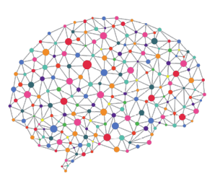
Cancer Classification using Deep Learning on Matched Biopsy Images and RNA-Seq
One Year Confirmation Seminar
Peter Donnelly
DD MMMM 2020
peter.donnelly@petermac.org

Slide 2
Agenda
Clinical Context, Hypothesis and Project Objective
“A classifier trained on BOTH Whole Slide Images AND RNA-Seq will classify cancers better than existing image or RNA-Seq specific classifiers”
Neural Network based classifiers:
How they work
How to evaluate / compare performance
Progress:
The classifier I’ve developed over the past 12 months
Some preliminary results applyig it to stomach cancer
Bringing it all together: the next 18 months

Slide 3
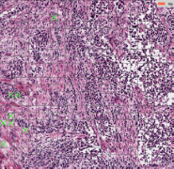
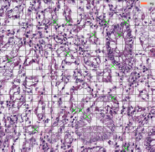
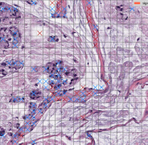
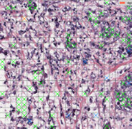
Clinical Motivation
Clinical Context
Cancers are still mainly detected and classified by inspection of biopsy tissue
but some are difficult or impossible to classify visually ...
… and two pathologists can classify the same sample differently
Classification determines treatment, so accurate classification matters
Automated Classification
Active area of research
The best classify ‘straightforward’ cancer subtypes very well
They use either images or RNA-Seq
Why not use both ?
Biopsy images of the four main Stomach Adenocarcinoma
cancer sub-types (classified by my classifier)
Diffuse
Tubular
Diffuse
Mucinous
Signet Ring

Slide 4
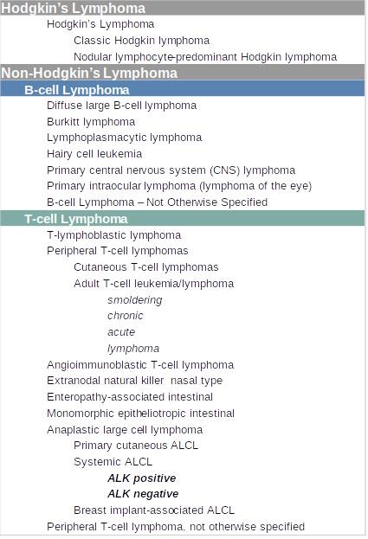

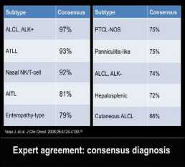
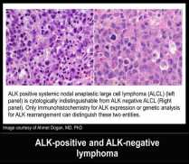
Lymphoma Classification
Pathologists find some T-Cell Lymphomas difficult to classify
  ALK+ and ALK- are almost indistinguishable
  Treatment for each differs
  + sub-type has the better prognosis
A Pathologists Guide to the Accurate Diagnosis of Peripheral T-Cell Lymphoma

Slide 5
Hypothesis & Objectives
Hypothesis
A classifier trained on BOTH images AND RNA-Seq will
classify any cancers,
classify challenging cancers,
better than existing image or RNA-Seq specific classifiers
Has not been tested to date*
Key Assumption
Image & RNA-Seq don’t embody identical
classification relevant information
Objectives
Develop such a classifier
Show that it performs better than existing classifiers
RNA-Seq
Image
information relevant to classification is likely to overlap greatly but not completely

Slide 6
Aims
Aim 1 is by far the largest task
Aim 1 – Build Classifier
Develop a classifier capable of testing the hypothesis
Success criteria: demonstration of a classifier able to classify arbitray TCGA (i) image (ii) RNA-seq data (iii) matched data
Metrics: Classification Accuracy, Precision, Recall
Aim 2 – Test the Hypothesis using TCGA Data
Success criterion: Classification performance better than any published paper classifying the same TCGA dataset
Metrics: Classification Accuracy, Precision, Recall, AUC
Aim 3 – Test the Hypothesis using PMCC TCL Data
Success criterion: Classification performance equal to an experienced human Pathologist for the same subtypes, as documented in appropriate published paper(s) selected or validated by PMCC Oncologist
Metrics: determined by the metrics used in the selected paper(s)
Progress
90%
10
%
5
%

Slide 7
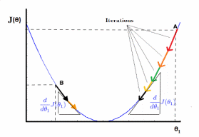

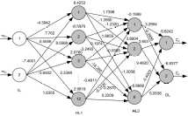

The Classifier: Supervised Neural Network
Phase 1: Training (80% of examples)
Inputs
Process
Output
Examples labelled with classes
iteratively improve model weights
optimized model
Muc
Tub
Tub
Diff
Muc
Muc
Diff
Tub
Muc
Diff
Diff
Sig
Tub
Diff
Phase 2: Testing (20% of examples)
Inputs
Process
Outputs
unlabelled examples
push inputs through optimized model
labels
?
Diff

?
Muc

?
Muc


Slide 8


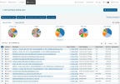



My Experiment System / Classifier
Fetch Raw Data
Pre-process Raw Data
Realize Optimum Model
Classify
Analyse Results
break
images
into tiles
remove background & degenerate
tiles
normalize
Colors
Image Branch
tiles
patches
Numerical normalization
TCGA
Extract
RNA-Seq
data
Reduce dimens-
ionality
resolve
gene
names
RNA Branch
RNA-Seq

Slide 9
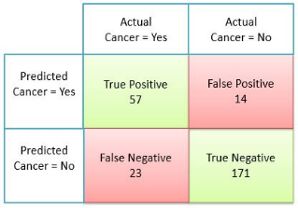
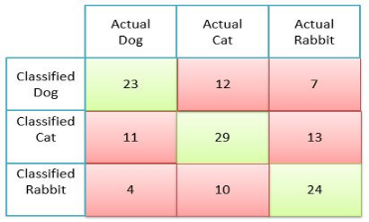
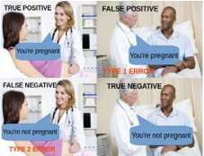
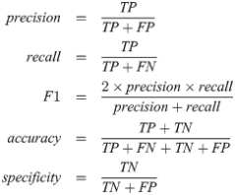
What Makes a Good Classifier?
Classifier effectiveness is evaluated with a Confusion Matrix
The confusion matrix below is for two classes ...
… but multi-class confusion matrices works identically
n=265
n=133
Demystifying Confusion Matrix and Performance Metrics in Machine Learning
All key statistics come directly from the Confusion Matrix
Understanding the Confusion Matrix

Slide 10
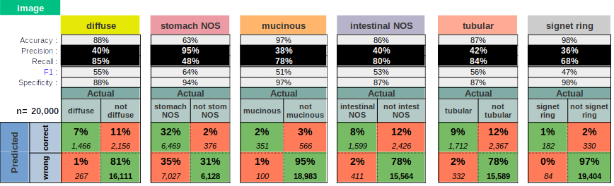
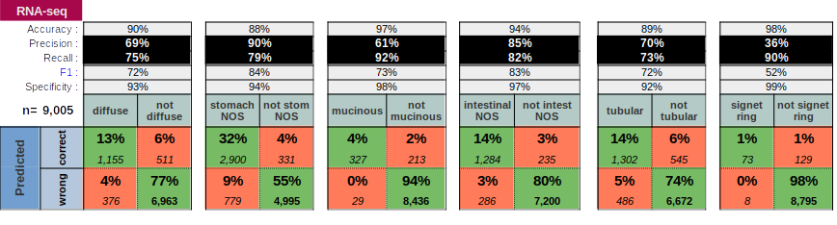
Preliminary Results
Classification of 20% held-out examples for Stomach Cancer: 4 runs (Images); 101 runs RNA-Seq

Slide 11
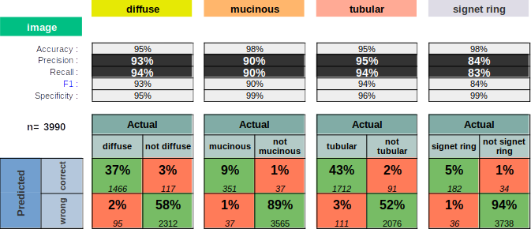
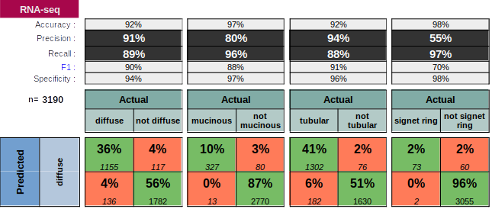
Just the Four Positively Defined Subtypes
(i.e. excluding the two NOS subtypes)
Conclusion: The NOS subtypes are significant confusers

Slide 12
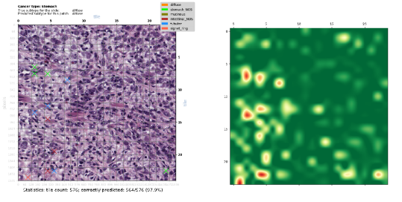
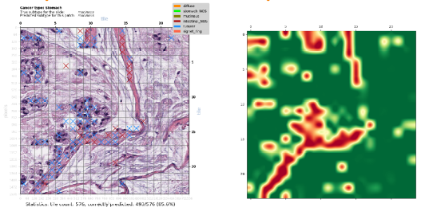
Classification of Contiguous Patches: Many Tiles From Same Sample
Randomly selected 24x24 tile patches (576 tiles)
Cross (‘X’) colour shows misclassified tile subtype; heatmaps show tile-level prediction confidence p(0,1)
Highly Confident and
Correct Prediction of Diffuse Subtype
(564/576=97.9% of tiles)
Moderately Confident and Correct Prediction of Mucinous Subtype
(485/576=85.6% of tiles)

Slide 13
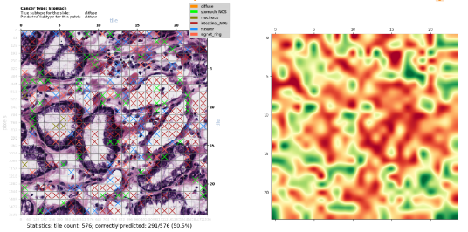
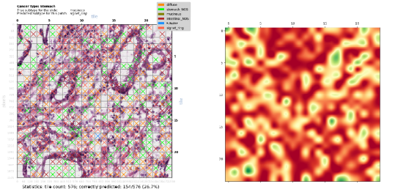
Classification of Contiguous Patches: Many Tiles From Same Sample
Randomly selected 24x24 tile patches (576 tiles)
Cross (‘X’) colour shows misclassified tile subtype; heatmaps show tile-level prediction confidence p(0,1)
Unconfident
but Correct Prediction of Diffuse Subtype
(291/576=50.5% of tiles)
Badly Wrong Prediction of Diffuse Subtype
as Signet Ring Subtype
(154/576=26.7% of tiles)
This is the worst misclassification of all 229 images

Slide 14
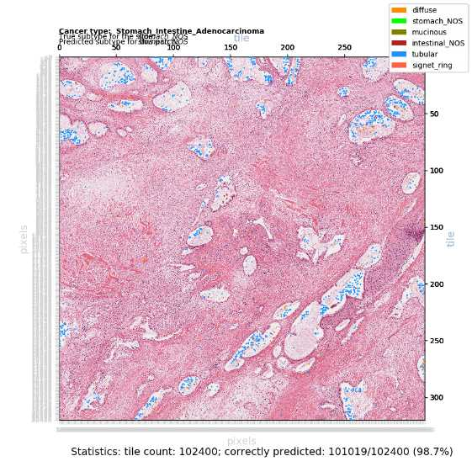
Classification of Larger Patch:
Patch of 320 x 320 = 102,400 tiles (420 mega-pixels)
The pink areas are correctly classified
The blue and orange areas are misclassified

Slide 15
Bringing it All Together: The Next 18 Months
Complete the Classifier
Support for match samples (multimode)
Support for multiple magnification levels
Perform the Experiments that will test the Hypothesis
Using TCGA data
Using PMCC Lymphoma data
Write the Thesis

Slide 16
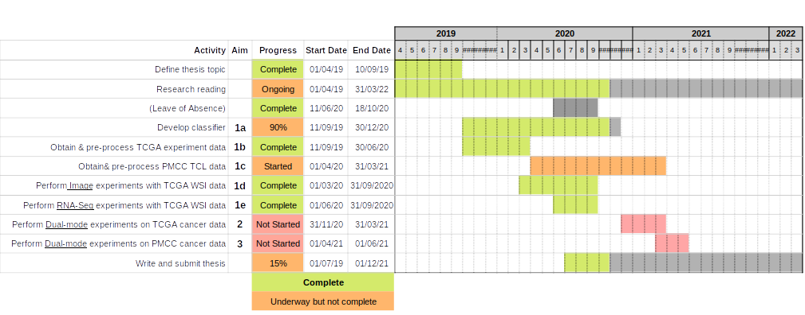
Overall Timeline

Slide 17
Spare

Slide 18
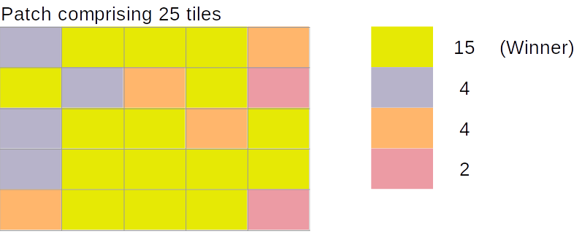
Scoring
Tile Level Scoring
Class with the highest probability wins
Patch Level Scoring
Add up the number of tiles in each class as per Tile Level Scoring
Class with the most number of tiles wins

Slide 19
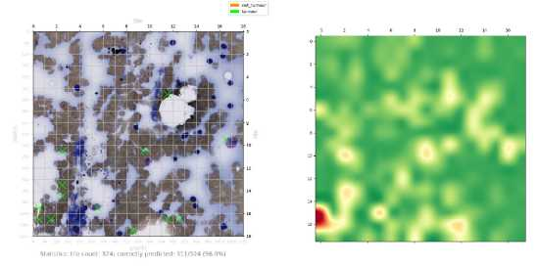
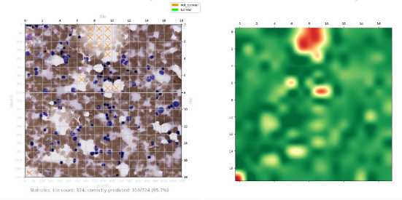
TCL Images:
Trained on only 9 images – ignore classifications

Slide 20
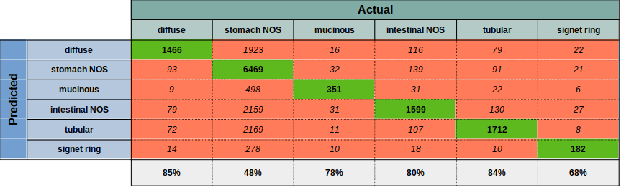
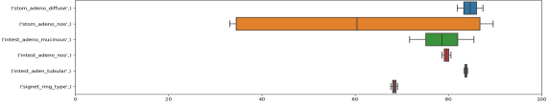
Preliminary Results: Subtyping 229 TCGA STAD Whole Slide Image Samples
Predicted vs True subtype for held out samples. 4 runs
Classification of 229 TCGA STAD H&E stained tissue samples (Six subtypes including two NOS subtypes)
Each sample is represented by 2500 randomly selected 64x64 pixel tiles. Background and degenerate tiles are excluded
Total of 229 x 2,500 = 572,500 tiles used for training and validation testing: 80% (n=458,000) training set + 20% (n=114,500) validation
5000 randomly chosen held-out tiles are tested after each run, yielding 20,000 total predictions of held-out tiles
Neural Network details: VGG11 = 11 layer convolutional (relu + softmax activation) network; ADAM optimiser. Reasonably well tuned
20 epochs per run. Each of the 4 runs produces a slightly different optimised classifier. See box plot
Observations
Classification accuracy ranges from 48-85% (all subtypes). Misclassification to NOS accounts for most misclassifications (35%)
Classification accuracy rises to 95-98% when the two NOS categories are removed (slide after next)
Much less variance between runs than for RNA-Seq, except for stomach NOS which has very high variance
No obvious explanation for the high variance between runs seen with stomach NOS
Classification of 5000 held-out tiles for each run (=20,000 predictions total) - All Six Subtypes
Replicability: percent correct for each category over the 4 runs

Slide 21

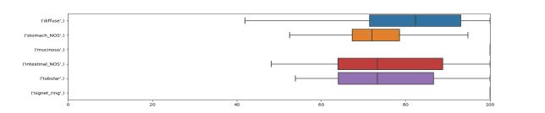
Preliminary Results: Subtyping 479 TCGA STAD RNA-Seq Samples
Predicted vs True subtype for held out samples. 101 runs.
Classification of 479 TCGA STAD RNA-seq samples (Six subtypes)
Each example is a vector comprising 60,483 mRNA + lnRNA Upper Quartile FPKM values (Frequency per kilobase per million reads mapped)
479 RNA-Seq examples per run for training & validation testing: 80% (n=383) training + 20% (n=96) validation testing
All held-out samples are tested after each run yielding 96 x 101 = 9,696 total predictions of held out samples over the 101 runs
Neural Network details: 3 layer fully connected network (relu + softmax activation); ADAM optimiser. Reasonably well tuned
200 epochs per run. Each of the 101 runs produces a slightly different optimised classifier. See box plot.
Observations
Absolute (rather than differential) RNA-seq expression data contains sufficient information to classify STAD subtypes quite well
Classification accuracy ranges from 70-90%% across the six subtypes
Misclassification to NOS accounts for most misclassifications (48%). This makes sense, as NOS is a heterogeneuous catch-all subtype.
Classification accuracy rises to 94-98%% when the two NOS categories are removed (next slide)
Classification of held-out test sets for each run (=9,696 predictions total) - All Six Subtypes
Replicability: percent correct for each category over the 101 runs

Slide 22
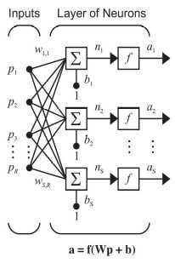

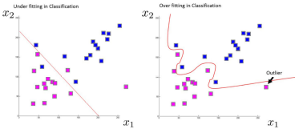
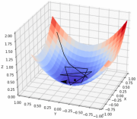
Neural Networks for Cancer Classification: Learning from Data
While there are many good classification algorithms (SVN, Random Forest ...), supervised neural networks are particularly effective classifiers
A Deep Learning network is just a neural network with many layers of neurons
With any kind of supervised neural network:
experts (e.g. pathologists) supply correctly labelled examples;
the network iteratively learns from this ‘Training Set’, resulting in a model which, hopefully;
generalizes well and can classify new, unseen examples (Test Set)
In more detail:
Start off with random weights (w_{i,i})
process a batch of inputs (p) from the Training Set
quantify batch loss: true ‘minus’ predicted classes
apply chain rule to loss, then update weights
try again with new weights
do over and over
Periodically validate with examples randomly drawn from the Test Set
signet_ring_type
intest_adeno_nos
stom_adeno_diffuse
Vito Gentile on Stack Overflow forum
With a pencil: 1 dimensional curve classifying 2 classes
With an NN: perhaps 100,000 dimensional hyperplane classifying (say) 6 cancer subtypes
When training a well parameterized model, most iterations will result in the loss (black line) reducing; stepping towards the minimum of the red/blue sheet corresponding to maximum classification accuracy
Microsoft - Tokyo DMM Machine Learning Tech Talk
Introduction to Optimization in Deep Learning: Gradient Descent

Slide 23
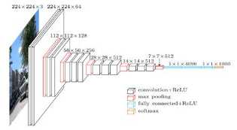
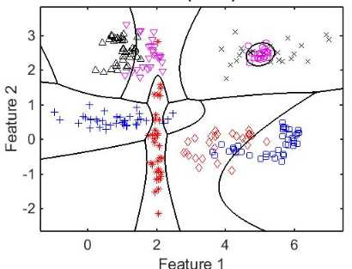

Automatic Classification: Learning from Data
‘VGG16’ – A Convolutional Neural Network
Many good classification algorithms (SVN, Random Forest …)
Supervised neural networks are particularly good
Deep Learning network = neural network with many layers
The classifier below is using 2 features to classify 8 classes
For the TCGA Stomach Cancer dataset (8 classes) I use:
  Images: 3x64x64=12,288 features
  RNA-Seq: 60,482 features
Understand the architecture of CNN
multi-class classification

